Slide 1
LimbRevive: VR-Based Therapy for Motor Recovery
InnovAct 2025
AR/VR
HEAL
IR2025-995954
https://github.com/PavihaaChander/InnovAct2025_HEAL.git
Pavihaa Lakshmi B, Marimuthu R, Saqhibuddeen Ahmed F, Keerthana B, Abitha V

Slide 2
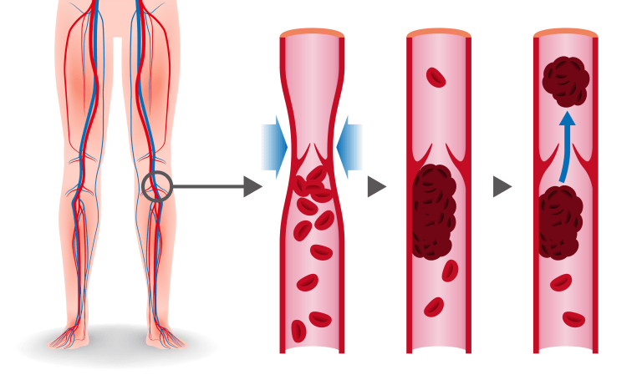
INTRODUCTION
Diagnosis early stage Deep Vein Thrombosis (DVT)
Nearly 9L people are affected and 1 to 2 per 1,000 could be affected each year. The National Centre on Birth Defects and Developmental Disabilities estimates that DVT kills 60,000 -100,000 every year.
All over India
Especially after major lower limb surgery and post pregnancy period.

Slide 3
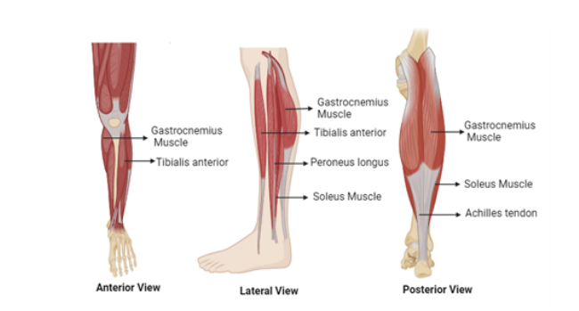
Calf muscle

Slide 4
Problem Statement
Background: Motor impairments caused by neurological disorders, trauma, or degenerative diseases severely affect individuals' ability to perform daily tasks, leading to reduced autonomy and quality of life.
Limitations of Traditional Therapy:
Conventional rehabilitation methods often face challenges such as:
Low patient engagement and motivation
Limited personalization of therapy
Restricted access in remote or underserved regions

Slide 5
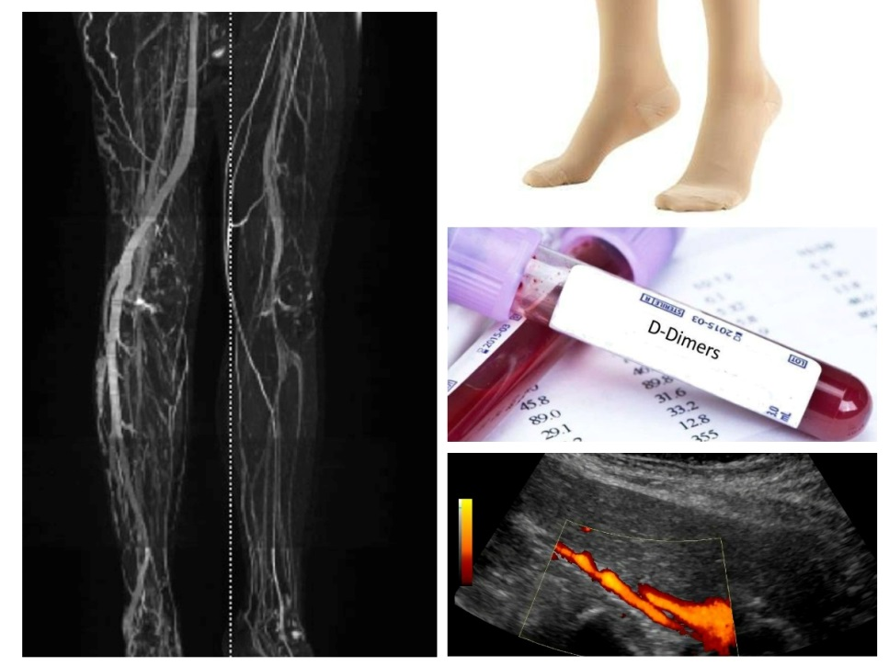
Existing Techniques
D-dimer blood test
Duplex ultrasound
Venography
MRI scan
Compression stockings

Slide 6
What does it solve?
VR-Based Game Therapy:
Virtual Reality (VR) offers immersive, interactive environments that simulate real-world motor tasks.
Game-based therapy within VR platforms can:
Enhance patient motivation and adherence
Stimulate neuroplasticity through repetitive, goal-oriented tasks
Allow real-time feedback and adaptive difficulty levels

Slide 7
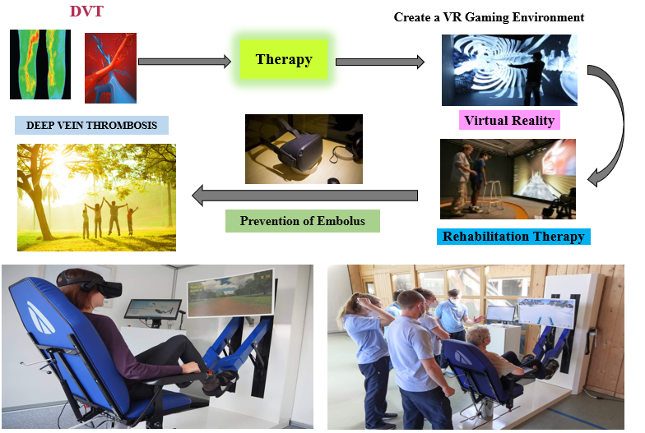
TECHNOLOGY/PROCESS SOLUTION

Slide 8
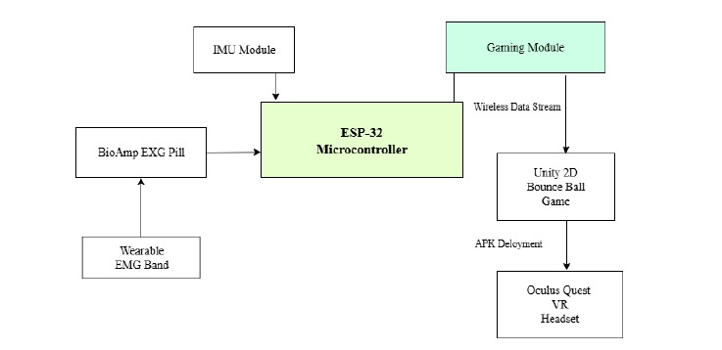
METHODOLOGY

Slide 9
Technical approach
Tools:
Unity, Arduino IDE
Components used:
ESP32
EXG PILL
MPU6050
Battery
Technologies:
Combining VR, Bio-signals, and motion sensing for rehabilitation in an interactive game-based therapy.

Slide 10

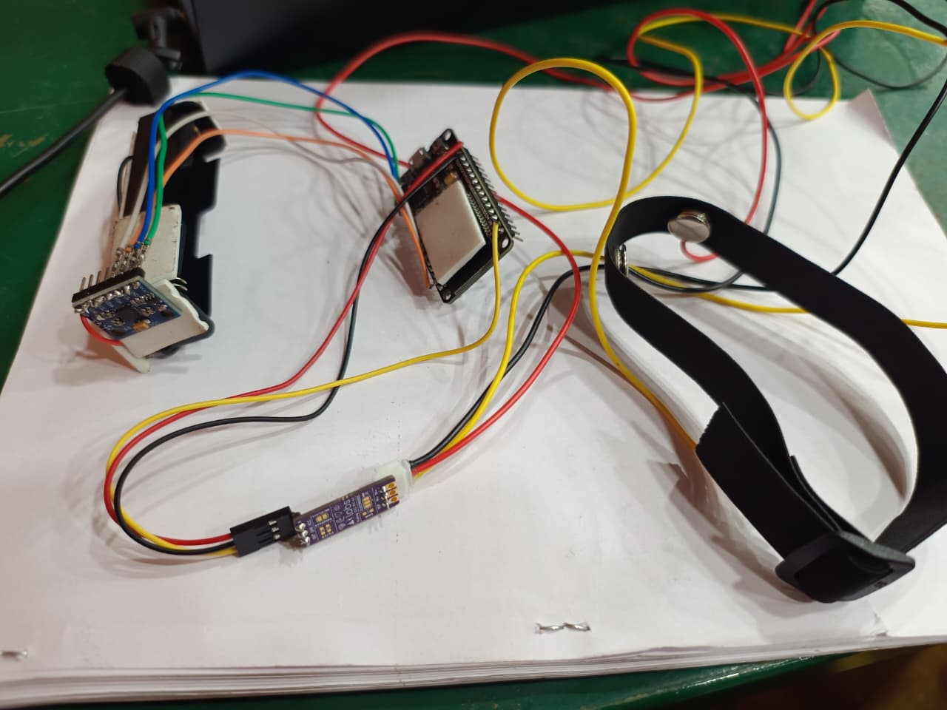
Prototype

Slide 11
Impact & use case
Who benefits?
The people who have been disabled by trauma, or people getting rehab after a stroke.
The physiotherapist and occupational therapist.
How can it be applied in real-world scenarios?
These devices can be used in Occupational therapy clinics.
These can be used as home-based therapies and can also be accessed in remote areas.

Slide 12
Challenges faced
Signal Integrity and Calibration:
Real-Time Integration: Synchronizing biosignals with Unity3D gameplay demanded low-latency data handling and precise temporal alignment.
Personalized Therapy Adaptation
Hardware Compatibility and Ergonomics

Slide 13
Future scope
The current prototype can be fully developed, and the sensors can be placed within a band wirelessly.
More games can be developed for each kind of daily living activity.
This device can be distributed even in rural hospitals so that each person in need can access this therapy.

Slide 14
Conclusion
Our research performs the design and implementation of a wearable smart insole hardware system unified with VR to support real-time monitoring and rehabilitation of lower limb muscles, with the goal of preventing DVT.
The system targeted key muscle groups- involving the gastrocnemius, soleus, tibialis anterior, tibialis posterior, and peroneus longus-whose contractions play a vital role in venous blood return.
EMG and IMU (accelerometer and gyroscope) data were collected from healthy participants during both resting and active state involving plantarflexion, inversion, and eversion movements.
After signal preprocessing and feature extraction, a range of time- and frequency-domain features were used to train classification models.

Slide 15
Thank you

